Slide 1
D214 Task #3: presentation of findings
Presented by Raquel ocasio

Slide 2
introduction
Who am i?

Slide 3
About me and my background
My name is Raquel Ocasio and I’m a graduate student in the Data Analytics program of Western Governors University.
My undergraduate degree is in web design and development.
I’m currently employed as a webmaster where I get to work with website analytics data.

Slide 4
Problem and hypothesis
What are we trying to do?

Slide 5
What are we trying to do?
We want to know if a multiple linear regression model can be constructed based on the research dataset.
The null hypothesis is: A predictive multiple linear regression model cannot be made from the research dataset.
The alternative hypothesis is: A predictive multiple linear regression model can be constructed from the research dataset at a model accuracy >= 70%.

Slide 6
Summary of the data analysis process
How it was done

Slide 7
How it was done - preparation
The data analysis process included data extraction, preparation, and analysis. The R programming language was used for all processes.
The data was downloaded from the Kaggle website at https://www.kaggle.com/datasets/stefanoleone992/mutual-funds-and-etfs. The dataset is made up of several CSV files. The file used for this study is “MutualFunds.csv.”
The data was prepared by checking for and treating duplicates, missing values, and outliers. Duplicate values were deleted. Missing values were imputed in depending on the distribution of the variable. No outliers were found in the data.

Slide 8
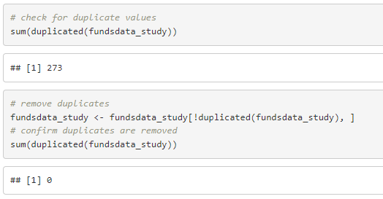
Screenshot of data preparation

Slide 9
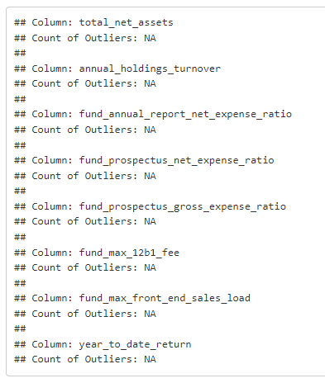
Screenshot of data preparation

Slide 10
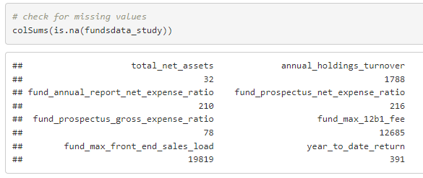
Screenshot of data preparation

Slide 11
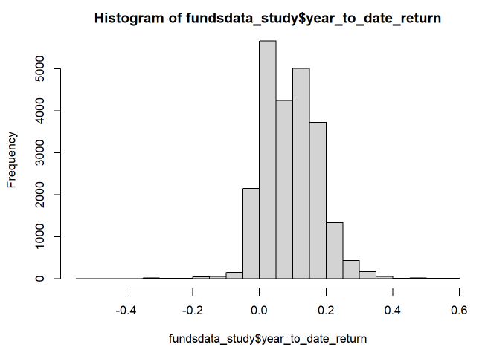
Screenshot of data preparation

Slide 12
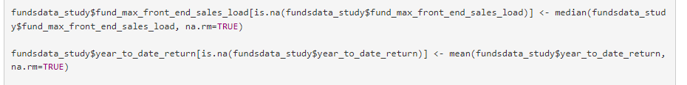
Screenshot of data preparation

Slide 13
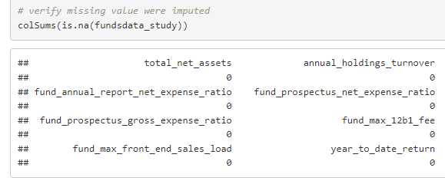
Screenshot of data preparation

Slide 14
How it was done - analysis
The data was analyzed by first checking if any of the independent variables had a linear relationship with the dependent variable to determine if multiple linear regression was appropriate for the analysis. This was done by generating scatterplots of each independent variable compared to the dependent variable. No linear relationships were found.
An initial multiple linear regression model was created using all the independent variables. The model summary was inspected and the error rate calculated. A final model was created using only those variables with a significant t-value. The model summary was inspected for the final model, and the error rate calculated. The error rates for each model were compared to determine which was better.

Slide 15
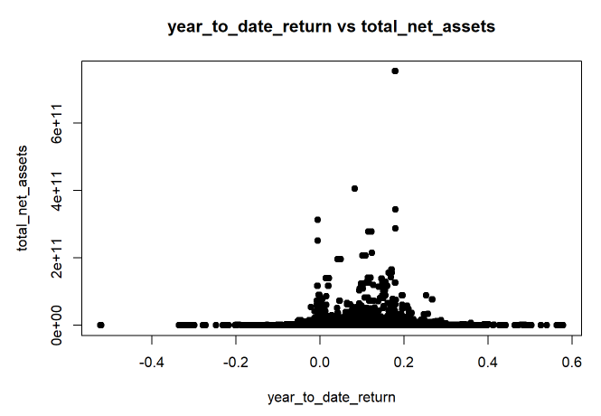
Screenshot of data analysis

Slide 16
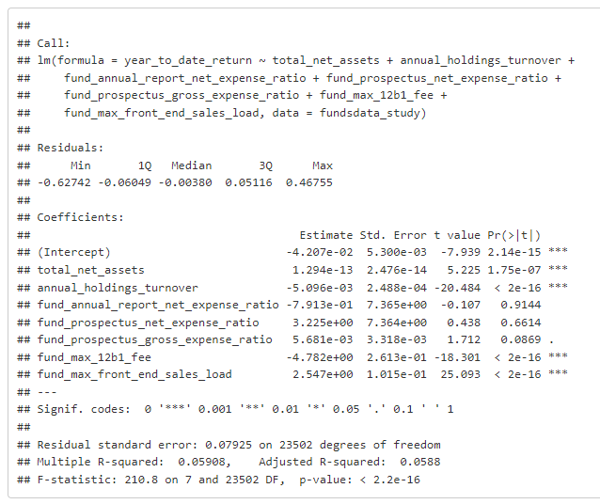
Screenshot of data analysis

Slide 17
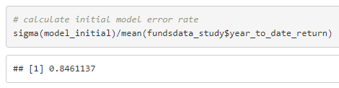
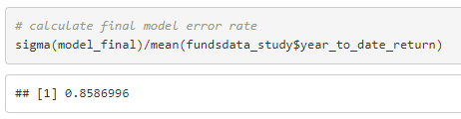

Slide 18
Outline of the findings
the results of the analysis

Slide 19
The results of the analysis
The error rate for the initial model was 84.6%, and the error rate for the final model was 85.9%.
While the initial model error rate of 84.6% was better than the final model, the error rate was very high. This indicates that neither model was a good predictor for the dependent variable, therefore we fail to reject the null hypothesis.

Slide 20
Limitations of the techniques and tools

Slide 21
Limitations during data preparation and analysis
A limitation of using these tools and techniques for data preparation is that it is very manual in nature and therefore time consuming.
A limitation of the technique used to generate the final model is that it requires a manual iteration process to potentially produce a better result.

Slide 22
Summary of proposed actions
What should be done with this new information?

Slide 23
recommendations
Based on these results, it is recommended that the models not be used for predicting values of the dependent variable.
It is further recommended that a model be generated using other variables than the ones used in this study in the hopes of obtaining a model with a much lower error rate.

Slide 24
Expected benefits of the study
How this new information could be helpful

Slide 25
Who would find this useful?
The contribution of this study to the field of Data Analytics and the MSDA program is to create a predictive model which can estimate the year-to-date return of mutual funds so a brokerage can provide investment recommendations to its clients.

